Slide 1
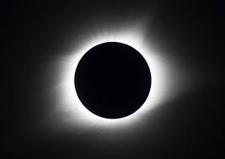
ECLIPSES:PERSPECTIVE IS EVERYTHING
TEAM SAKKS: Roy Joy Wilfred Ian Felix Kish
Emory Victoria Edi

Slide 2
Project overview
Eclipses are awe-inspiring celestial events that drastically change the appearance of one of the two biggest objects we see in our sky: our Sun and Moon.
Project objectives
To explain :
    How solar and lunar eclipses occur
    What causes the Sun , Moon and Earth to align?
    How often do eclipses occur?
    Differences between Lunar eclipse and Solar eclipse.
    Why eclipses occur at different parts of the earth at different times ?

Slide 3

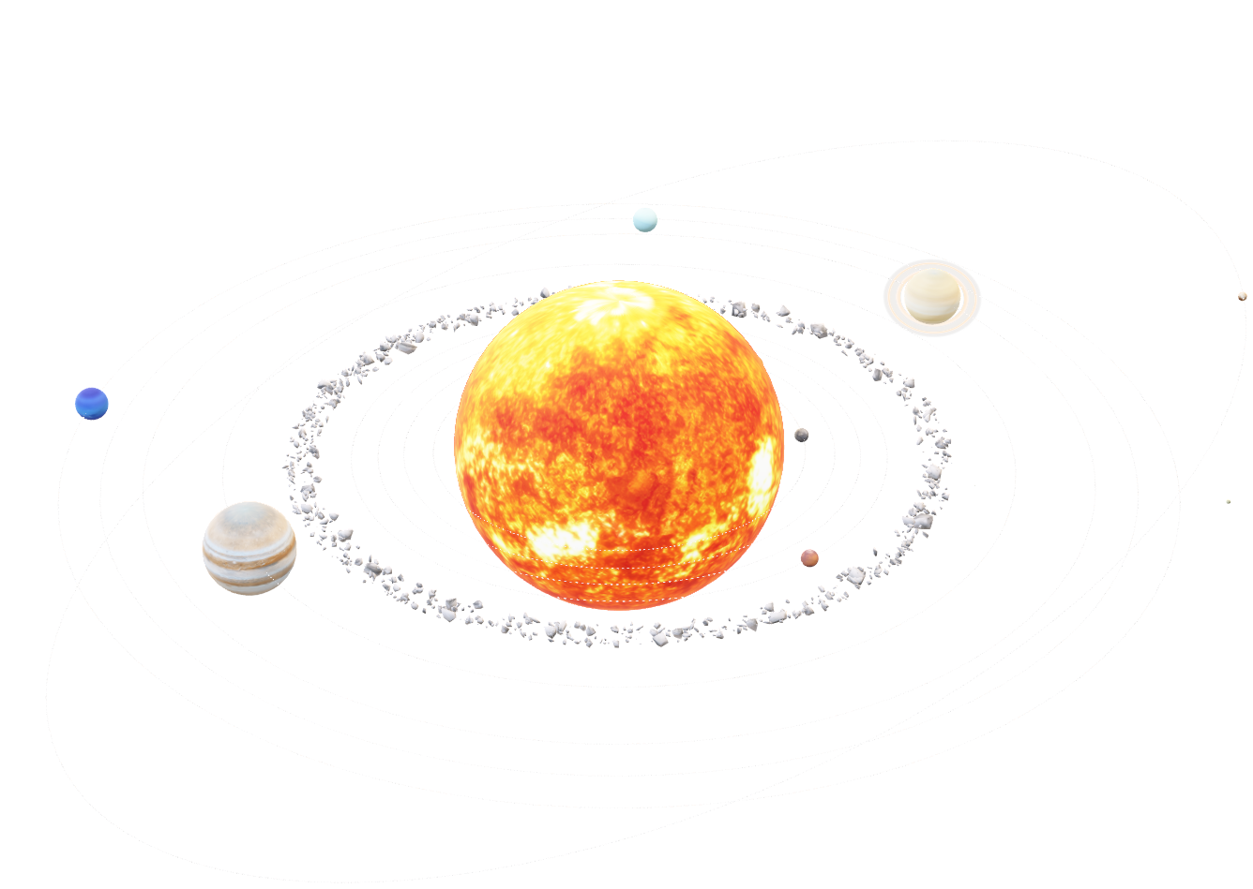
1.BACKGROUND INFORMATION
An eclipse is an astronomical event that occurs when an astronomical object or spacecraft is temporarily obscured, by passing into the shadow of another body or by having another body pass between it and the viewer.
There are two types of eclipses:
      Solar Eclipse
      Lunar Eclipse
There are four types of solar eclipses:
(total, partial, hybrid, and annular) .
There three types of lunar eclipses:
(total, partial, and penumbral).
An eclipse season is one of only two periods during each year when the Sun, Moon, and Earth are aligned, allowing eclipses to occur.
Each season lasts about 35 days and repeats just short of every six months.
There are two to five eclipses each year, with a total eclipse taking place every 18 months or so.
Click on the model to interact

Slide 4
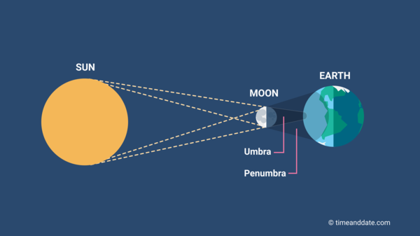
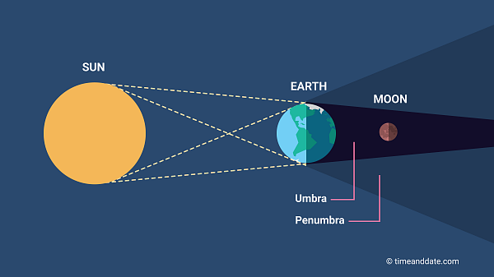
2. ECLIPSES EXPLAINED
Eclipses occur on our planet when the Sun, Moon, and Earth line up. Exactly how they align determines what kind of eclipse we see.
A solar eclipse happens when the Moon passes between the Sun and Earth, blocking at least some of the Sun and casting a shadow on Earth.
A lunar eclipse is an astronomical event that occurs when the Moon moves into the Earth's shadow, causing the Moon to be darkened.
fig1.1:SOLAR ECLIPSE
fig1.2:LUNAR ECLIPSE

Slide 5
WHAT BENEFITS DOES IT HAVE?
The way eclipses work, particularly solar eclipses, provides several benefits and opportunities for scientific research, education, and cultural significance
1.Gives young learners a better understanding of the solar system and its phenomenal.
2.Builds learners interest in science – Helping them make a connection with what they learn in school.
3.Promotes exploration within the learner.
WHAT DO YOU HOPE TO ACHIEVE ?
1.To inspire young learners to become innovative and boost their critical thinking .
2.To eliminate naïve and miscontrusted ideas of the solar system and occurrence.
3.To educate young learners on the science behind the occurrence of eclipses.

Slide 6
WHAT BENEFITS DOES IT HAVE?
The way eclipses work, particularly solar eclipses, provides several benefits and opportunities for scientific research, education, and cultural significance
1.Gives young learners a better understanding of the solar system and its phenomenal.
2.Builds learners interest in science – Helping them make a connection with what they learn in school.
3.Promotes exploration within the learner.
WHAT DO YOU HOPE TO ACHIEVE ?
1.To inspire young learners to become innovative and boost their critical thinking .
2.To eliminate naïve and miscontrusted ideas of the solar system and occurrence.
3.To educate young learners on the science behind the occurrence of eclipses.

Slide 7
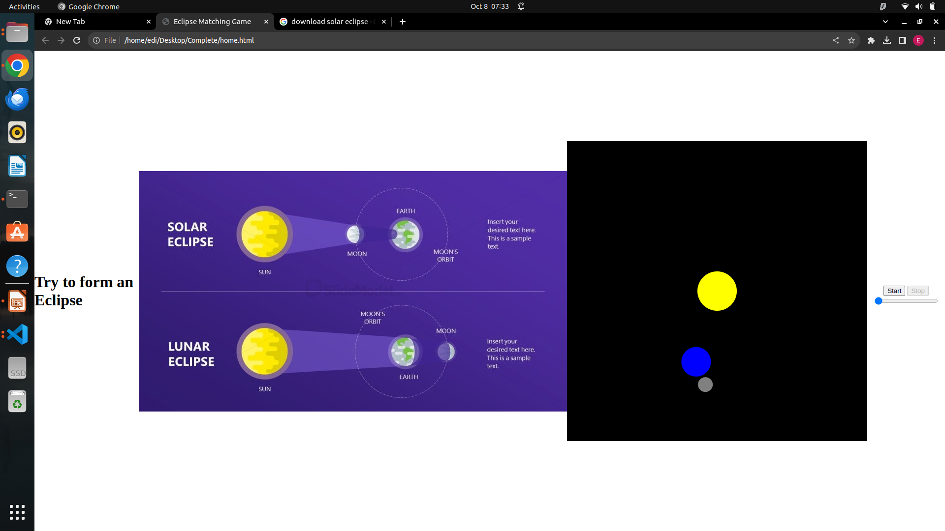
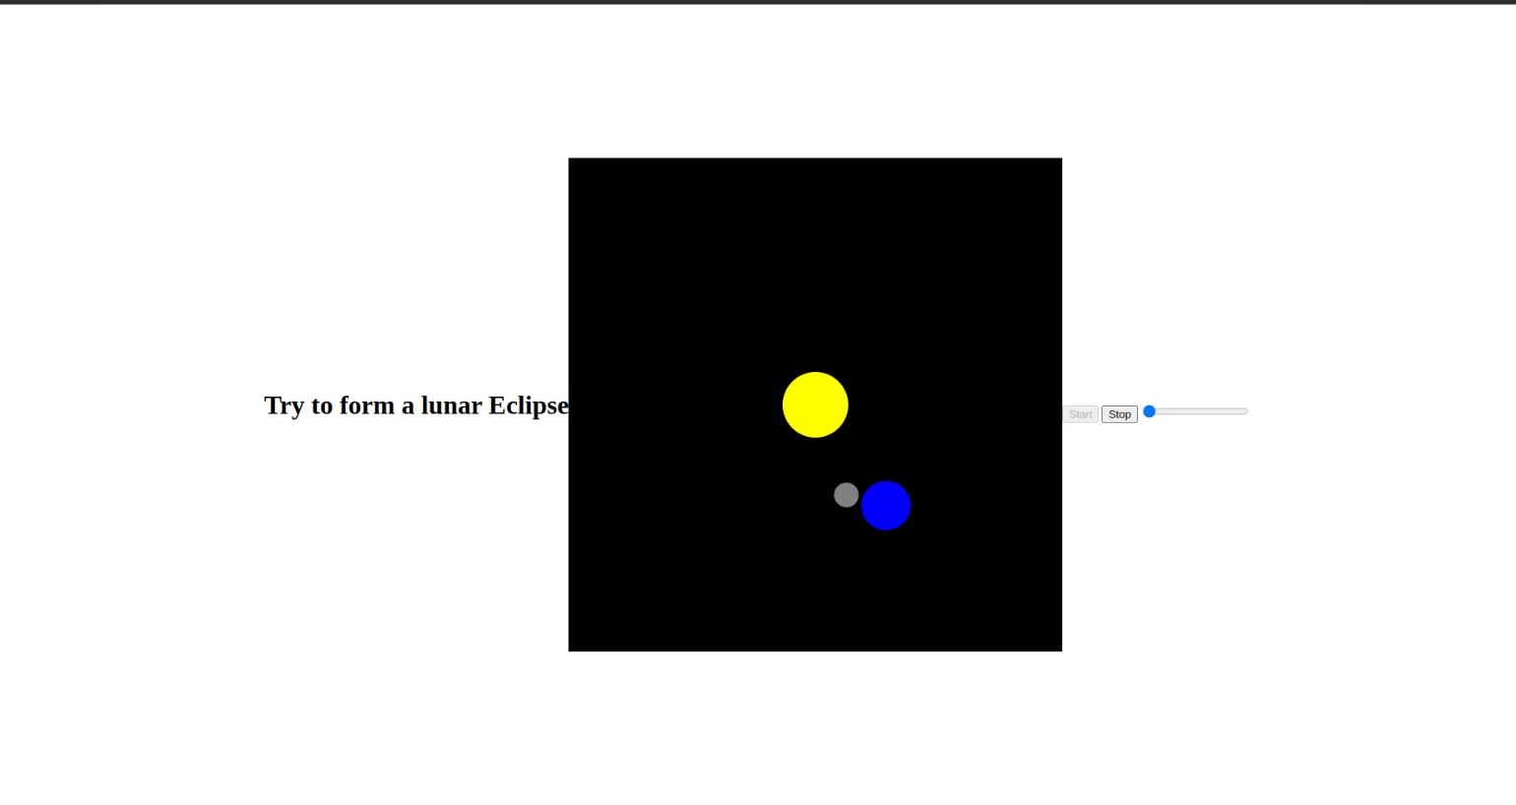

Slide 8
Why engage a young adult in learning eclipses
Engaging young learners in eclipses can be a valuable educational experience for several reasons
:1. Scientific Curiosity: Eclipses are fascinating natural phenomena that can ignite a child's curiosity about the universe, astronomy, and science in general.
2. Hands-On Learning: Observing and learning about eclipses through activities like eclipse-watching or building simple pinhole projectors can provide a practical and memorable science lesson.
3. Critical Thinking: Understanding eclipses involves critical thinking and problem-solving skills as learners explore why and how these events occur.
4. STEM Interest: Encouraging young learners to explore eclipses can foster an early interest in STEM (Science, Technology, Engineering, and Mathematics) subjects, potentially leading to future educational and career opportunities.

